Slide 1



Enhancing Social Inclusion of Youth Through Employment in Agri-Food Sector
Agreement Number: 2019-3-TR01-KA205-079155
Kick-off Meeting/Turkey
26.02.2020
INTELLECTUAL OUTPUTS OF AGRI-FOOD PROJECT
Dr. Banu AKGÜN
Food Engineer

Slide 2

Intellectual Outputs
The programme guide describes intellectual outputs (IOs) as ‘tangible deliverables of the project’.
Intellectual outputs are an extra opportunity (and funding) for projects aiming at a certain impact on a larger target group, within or beyond the partnership. If this impact requires the creation of material then IOs should come in as project outcomes.
Notes:
KA2 projects supporting innovation will normally include Intellectual Outputs.

Slide 3
Intellectual Outputs
Some specific requirements contribute to the quality of an intellectual output:
*Concrete, tangible products
*substantial in quantity
*proportional to the funding, realistic
*Answering the needs of the target groups, in line with the objectives of the project
*High impact potential for the intended target groups (local, national, international …)
*Tailored to the target groups, flexible applicability, potential for mainstreaming
*Sustainable-innovative: new product, new service, research based
*Available and accessible, multi-media carried

Slide 4
Intellectual Outputs
The beneficiaries shall not subcontract any activities funded from the budget category Intellectual Outputs.
The amount provided for intellectual outputs is based on the calculation of the human resources (i.e. staff per hour) needed to produce each output.

Slide 5
Staff Time Sheet
Name of employee
Function in the project
Project
Institution
Period
Date
Day | Month | Year | Description of Activities | Intellectual Output Worked |  | Hours
Total Hours Worked
Employee Signature: ………………………………… |  |  |  |  | Date: ………………………………
Project Contact Person Name: ……………………………
Project Contact Person Signature: ……………………………………………… |  |  |  |  | Date: ………………………………
Project Legal Representative Name: …………………………………………….
Project Legal Representative Signature: ………………………………………… |  |  |  |  | Date: ………………………………
*****The CV and the service contract of the employee should be attached

Slide 6
Intellectual Outputs
The timesheet is a mandatory documentation instrument for all those working with the development of the Intellectual Outputs. The timesheets completed during the duration of the project must be kept by the beneficiary organization and presented upon request to the National Agency granting the project or other control affiliated EU bodies and third parts.

Slide 7
Intellectual Outputs
The timesheet must be filled in monthly by each of the persons working with the development of the Intellectual Outputs. At the reporting time, it should also be sent to the beneficiary organization.
All persons working with the development of the intellectual outputs must fill in the timesheet. Based on the programme guide and the project application, those working with the development of the intellectual outputs are included in the following categories of staff: teachers/trainers/researchers

Slide 8
Intellectual Outputs
1. Need Assesment Survey /CRIFFC
2. Good Agricultural Practices (GAP): Precision Farming Training Material / CRIFFC
3. Agri-Food Marketing Training Material / TARIMAS
4. Agricultural Entrepreneurship Training Material / TARIMAS
5. Food Safety and Traditional Food Processing Technologies Training Material /CTC- Spain
6. Value-Added Food Products from Fruits and Vegetables Training Material / TFTAK- Estonia
7. E- Learning Module / GDAR

Slide 9
OUTPUT 1
Need Assesment Survey
Planned time interval → 01.03.2020-30.06.2020 (4 months)
Number of working days: 105
Medias →Text file, Social Media, Paper brochures, Website
Leading Organisation → CRIFFC
Participating Organisations → TARIMAS, CTC and TFTAK

Slide 10

Need Assesment Survey
OUTPUT 1
A report concerning the current situation of the target group in partner countries will be written and assessed. This report will show the social and training needs of the target groups, their competency levels and the problems that they encountered. It will guide during the development of innovative and understandable training materials and young tailored activities. These training materials and activities will be beneficial and practical to improve the skills and competence of targets groups and trainers.

Slide 11
OUTPUT 1
Need Assesment Survey
Task 1 (Desk Research): The desk research will be conducted by all partners.
Task 2 (Field Research): The current information about the agri-food sector will be obtained in partner countries by performing field research. Each partner will give information related to the number of young employees in the sector, the challenges that they faced, their training material needs and the qualification levels about agricultural and food processing practices etc.
Task 3 (Reporting): The reports coming from each partner will be evaluated by CRIFFC. A final report will be prepared and it will show us the needs of the target groups. Outputs and activities will be developed in the light of this report.

Slide 12
OUTPUT 1
Questionnaires
Evaluation of GAP: Precision Farming
B. Evaluation of Agri-Food Marketing
C. Evaluation of Agricultural-Entrepreneurship
D. Evaluation of Food Safety and Traditional Food Processing Technologies
E. Evaluation of Value-Added Food Products from Fruits and Vegetables

Slide 13
OUTPUT 2
Good Agricultural Practices (GAP): Precision Farming Training
Material
Planned time interval → 01.07.2020-28.02.2021 (8 months)
Number of working days: 105
Medias → Paper brochures, Text file, Website, Social Media
Leading Organisation → CRIFFC
Participating Organisations → TARIMAS, CTC and TFTAK

Slide 14

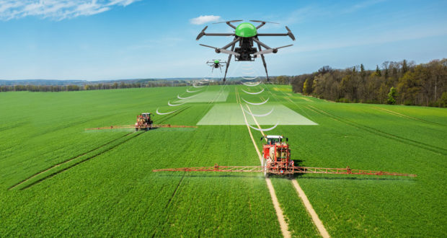
OUTPUT 2
The main objective of this task is to inform target groups about GAP, regulations and certification procedures and precision farming technology. At first, related and necessary information and documents will be gathered and analyzed. Then, innovative, coherent and free-of-charge training material will be prepared.
It will be a good source for target groups.

Slide 15

OUTPUT 2
Expected impacts;
-Fall in the rejection rate of agri-food products due to non-compliance with the GAP standards in EU countries
-Enhanced skills & competence of the target groups about GAP and precision farming
-Increased food safety and acceptance
-Protection of consumer health
-Innovative farming practices
-Increasing self-confidence of youth

Slide 16
OUTPUT 3
Agri-Food Marketing Training Material
Planned time interval → 01.07.2020-28.02.2021 (8 months)
Number of working days: 105
Medias → Paper brochures, Text file, Website, Social Media
Leading Organisation → TARIM AS
Participating Organisations → CTC, CRIFFC and TFTAK

Slide 17


OUTPUT 3
Agri-food marketing covers the services involved in moving an agri-food product from the farm to the consumer. Especially small-scale producers in Europe are facing problems during marketing their food products. Hence, farmers and food manufacturers should increase their knowledge about marketing strategies, channels and regulations, and they should follow consumer trends to cope with these challenges.
Any food to be sold in the EU must meet requirements of regulations in terms of production, control and labeling.

Slide 18
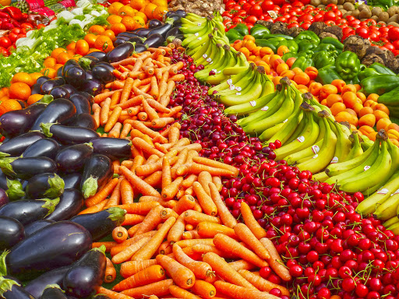
OUTPUT 3
Expected impacts:
-A decrease in the rejection of agri-food products due to not meeting the marketing standards
-Increased competence of target groups and trainers related to the agri-food marketing
-Increased awareness in terms of consumer behaviour and trends
-Increased self-confidence of future agri-food entrepreneurs

Slide 19
OUTPUT 4
Agricultural Entrepreneurship Training Material
Planned time interval → 01.07.2020-28.02.2021 (8 Months)
Number of working days: 105
Medias → Paper brochures, Text file, Social media, Website
Leading Organisation → TARIM AS
Participating Organisations → CTC,CRIFFC and TFTAK

Slide 20
OUTPUT 4
Agricultural Entrepreneurship Training Material will be prepared by the coordinator. TARIMAS gives importance to encourage agricultural production and promote rural development. In the near future, in the scope of cultivation of blueberry project, they distributed raspberry saplings to farmers in order to obtain a farm product with high export potential. TARIMAS will use its past experience and knowledge while preparing this material.
In this training material, place and importance of entrepreneurship in the agricultural sector, essential skills needed to be an entrepreneur, government grant for agricultural entrepreneurs, agricultural entrepreneurship fields and opportunities, key English words used in international trade, entrepreneurship practices in agriculture and successful examples in Turkey, procedures for opening agricultural workplaces and the cooperative system will be described.

Slide 21

OUTPUT 4
Expected impacts:
-To increase the spirit of agricultural entrepreneurship among youth
-To give guidance on agricultural entrepreneurship opportunities, government supports and procedures for opening agricultural workplaces
-To increase foreign language skills
-To introduce successful examples to young people related to agri-food practices
-To increase knowledge of the target group about cooperatives

Slide 22
OUTPUT 5
Food Safety and Traditional Food Processing Technologies Training Material
Planned time interval → 01.07.2020-28.02.2021 (8 Months)
Number of working days: 105
Medias → Social Media, Paper Brochures, Website, Text file
Leading Organisation → CTC
Participating Organisations → TARIM AS, CRIFFC and TFTAK

Slide 23
OUTPUT 5
Food safety is a crucial topic due to its impact on consumer health. However, studies showed that food safety knowledge of young people is at an insufficient level and their practices are inappropriate.
The traditional knowledge level of young people about food processing techniques is low. It is required to develop the knowledge, skills and talent of youth to obtain further sectoral development.
More qualified young people will have a higher level of self-confidence to start the agri-food business
Output contents are given below:
-Introducing Food Technology
-Understanding microorganisms in food. Most dangerous bacteria
-Importance of food safety
-How pasteurization and other traditional technologies are used during processing to improve food safety. Time Temperature relationship
-Types of containers and ingredients. Importance of closures and natural ingredients
-Aseptic processing and packaging systems
-Shelf life study of food products: determination of “best before” dates
-Other innovative technologies
-Basic points if you want to start working in the food industry

Slide 24
OUTPUT 5
Expected impacts:
-Increased competence and skills of young employees in the agri-food sector and trainers
-More uniform food industry practices
-Safer food to the markets
-Increased confidence of youth about agri-food business practices

Slide 25
OUTPUT 6
Value-Added Food Products from Fruits and Vegetables Training Material
Planned time interval → 01.07.2020-28.02.2021 (8 Months)
Number of working days: 105
Medias → Paper Brochures, Website, Text file, Social media
Leading Organisation → TFTAK
Participating Organisations → CRIFFC, TARIM AS and CTC

Slide 26
OUTPUT 6
This training material is written for young people who would like to increase their knowledge and skills related to processing produce. It is known that it is not easy to preserve fresh fruits and vegetables in an acceptable form for a long time so farmers may lose money due to the post-harvest losses.
Value-added food processing is something that you do to help make more money from your farm products. For instance, jams and pickles make great value-added farm products and shelf-life is getting longer. Value-added products are defined by USDA as a change in the physical state or form of the product such as making strawberries into jam.
Value-added products may open new markets, increase the public's appreciation for the farm, increase revenue as consumers are willing to pay more for extra value and extend the marketing period.

Slide 27
OUTPUT 6
Expected impacts:
-To give clear guidance on what is value-added food processing is
-To inform target groups about how to make and develop some value-added food products from fruits and vegetables (how to package them and where you can make them)
-To broaden young people's minds related to alternative value-added food products that have export potential
-To introduce successful practices concerning value-added food products from fruits and vegetables
-To increase the spirit of entrepreneurship and social integration

Slide 28
OUTPUT 7
E-learning module
Planned time interval → 01.03.2021-31.07.2021 (5 Months)
Number of working days: 90
Medias → Website, Social media
Leading Organisation → GDAR
Participating Organisations → CRIFFC, TARIM AS, TFTAK and CTC

Slide 29
OUTPUT 7
E-learning platform
An E-learning module will be formed by GDAR. It will present open educational course materials for guiding target groups about agri-food marketing, agricultural entrepreneurship, food safety and traditional food processing technologies and value-added food products from fruits and vegetable training material.
A technician and researcher will work together for this activity. E-learning Platform will be developed for all target groups where they can attend to the on-line course and receive distance training. Especially, for people who don't have a chance to attend to the physical workshop, conference. This platform will offer innovative and free-of-charge training materials for target groups and trainers. By this means, it will help the development of the agri-food sector by offering more qualified labour.

Slide 30

OUTPUT 7
Expected impacts:
*Delivering outputs to a high number of people
*Increasing competencies of young people interested in agri-food business via distance learning
*Providing new, innovative and high-quality training materials
*Helping to fulfill agri-food labour needs

Slide 31
Thank you…

